Slide 1
My Family Tree
Susan Smith

Slide 2
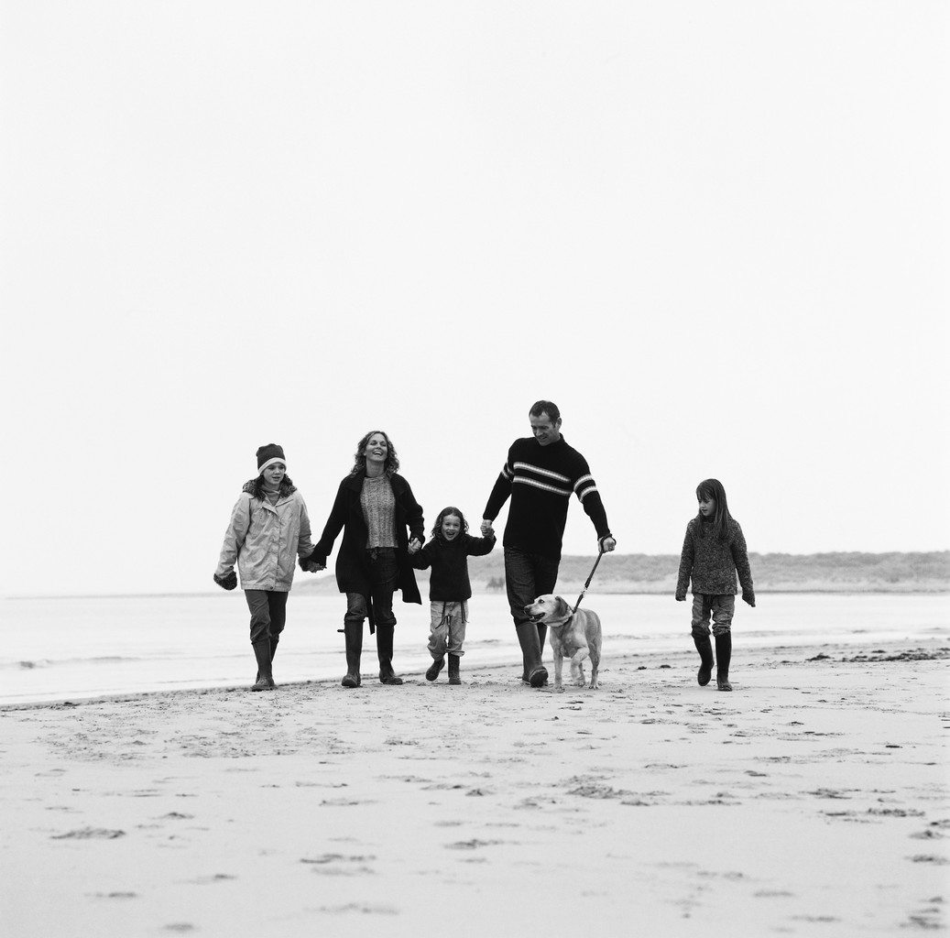
Relatives
Mom and Dad
Grandparents
Siblings

Slide 3
Jones Family
Mom and Dad
Susan
Jim

Slide 4

Dates
My parents were married in
My brother was born in

Slide 5

THE END

